Slide 1
ARM Instruction Set Part-II
Branch and Control
September 2021

Slide 2
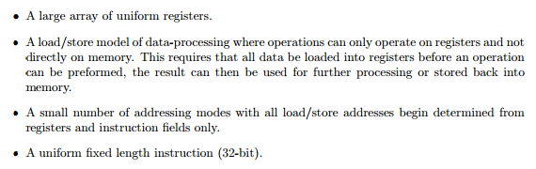
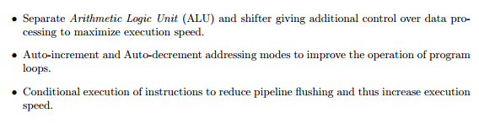

Recollect all these
ARM by Shriram

Slide 3
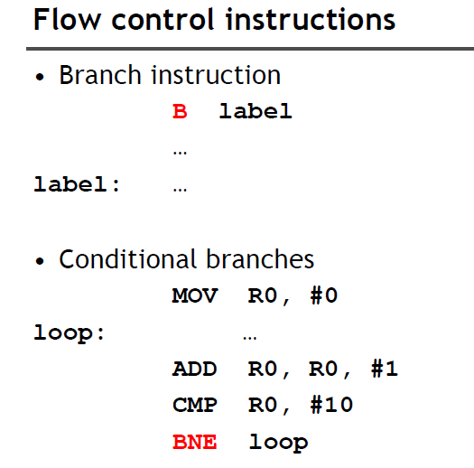

Slide 4
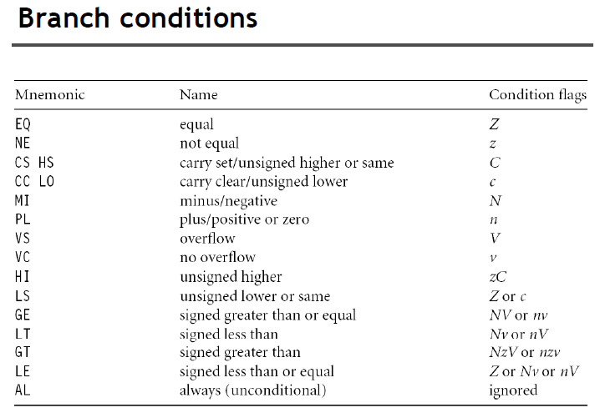

Slide 5
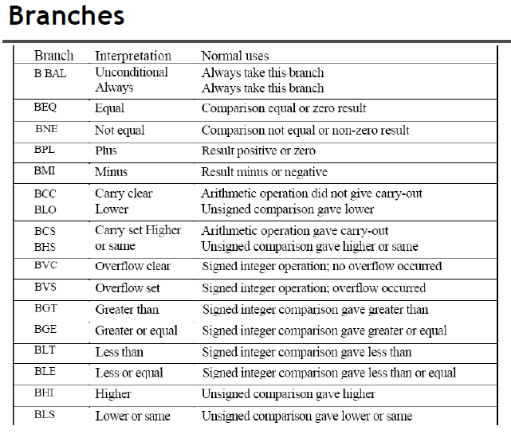

Slide 6
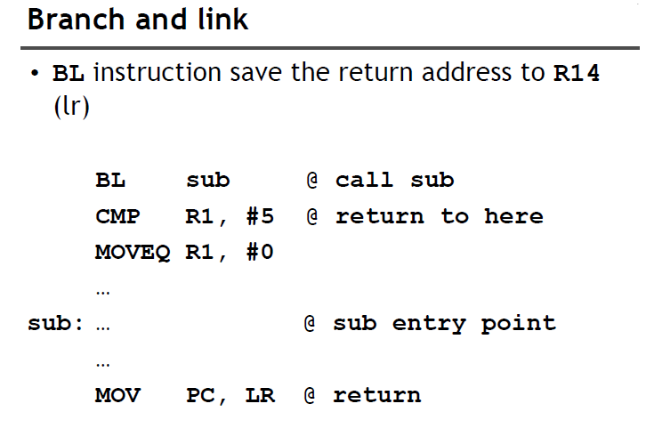

Slide 7
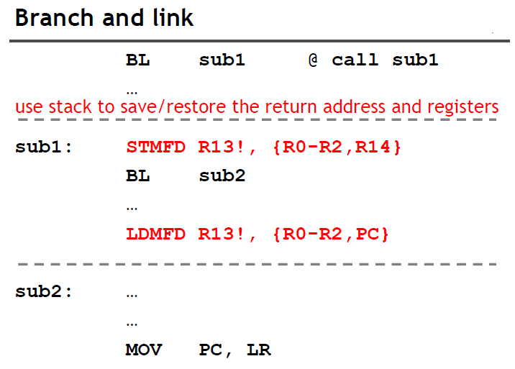
https://titanwolf.org/Network/Articles/Article?AID=c7d817a8-2c38-4c5a-9efb-0d5c503226d5#gsc.tab=0

Slide 8
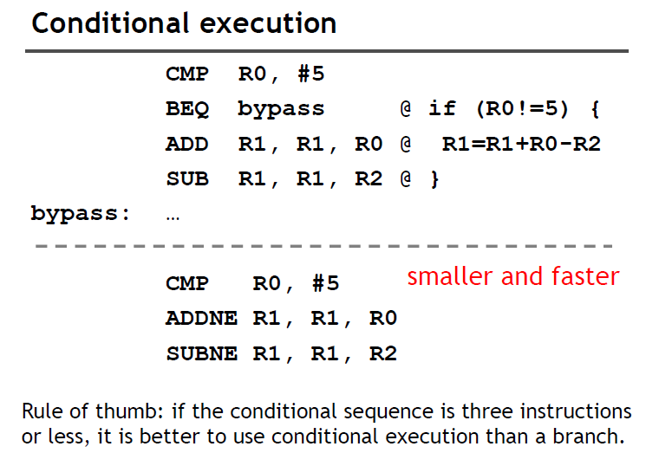

Slide 9
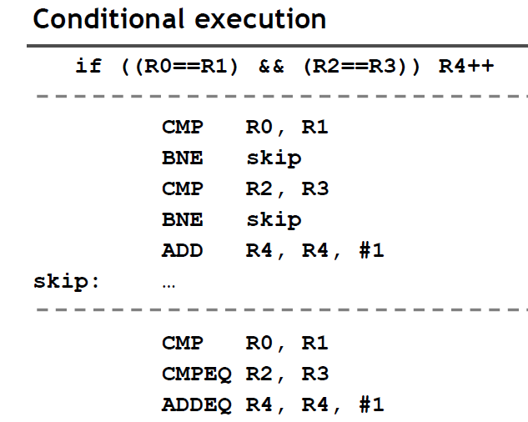

Slide 10
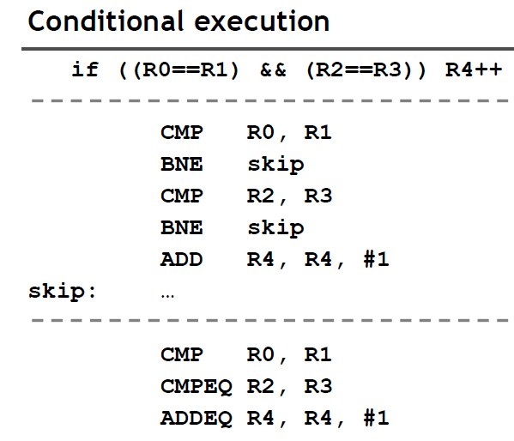

Slide 11
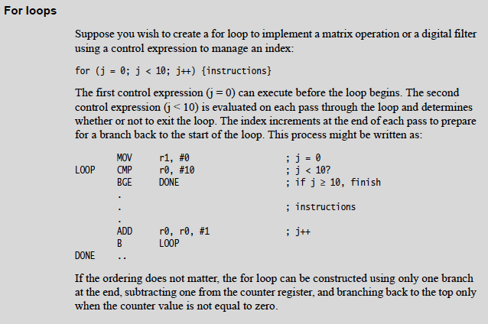
FOR LOOP – An Example code.

Slide 12
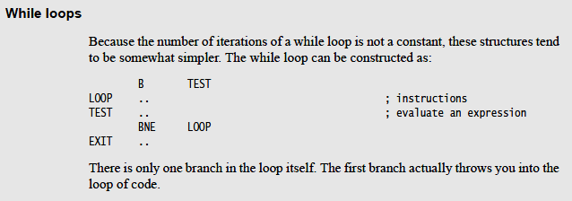
While Loop

Slide 13
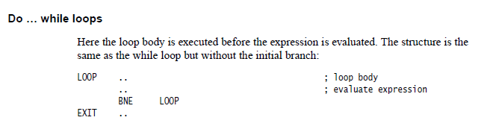
Do while

Slide 14
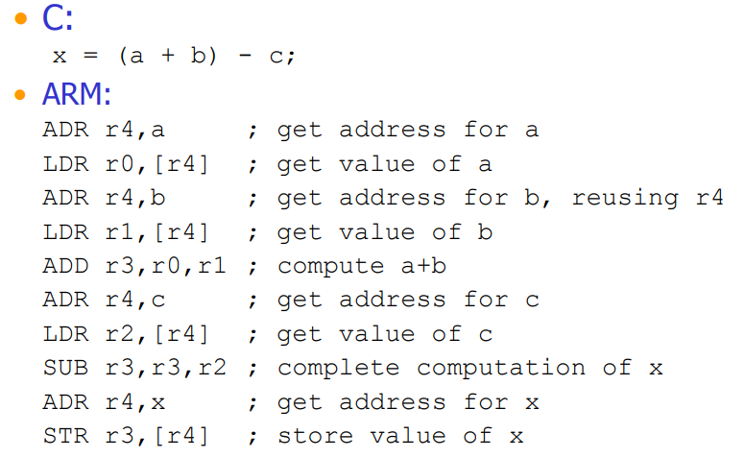

Slide 15
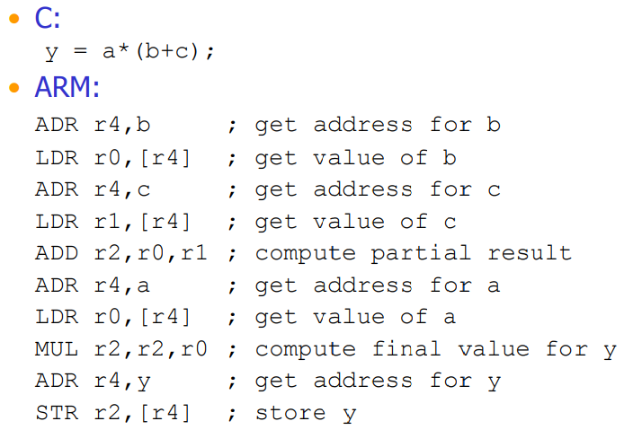

Slide 16
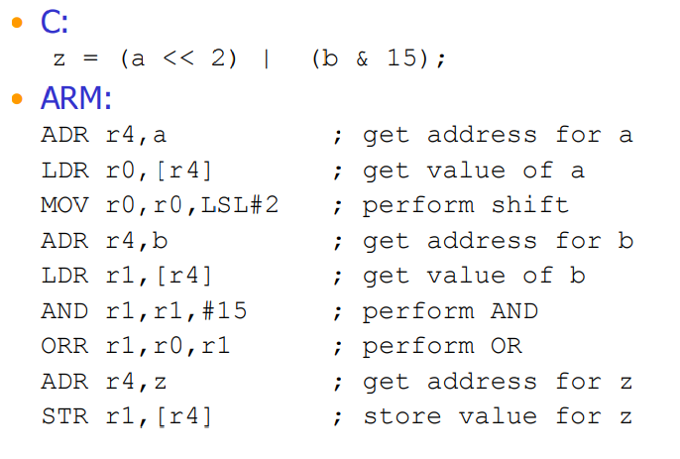

Slide 17
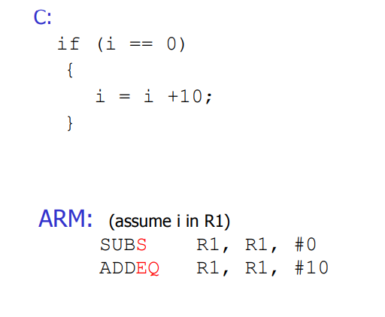

Slide 18
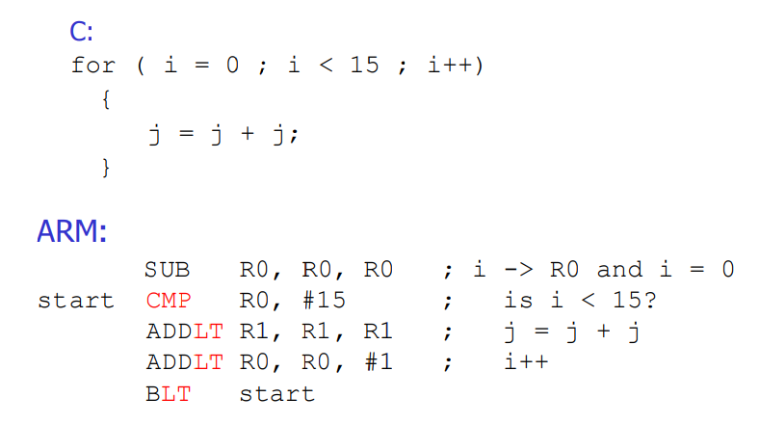

Slide 20
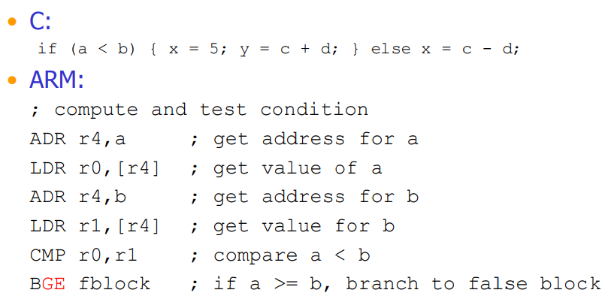

Slide 21
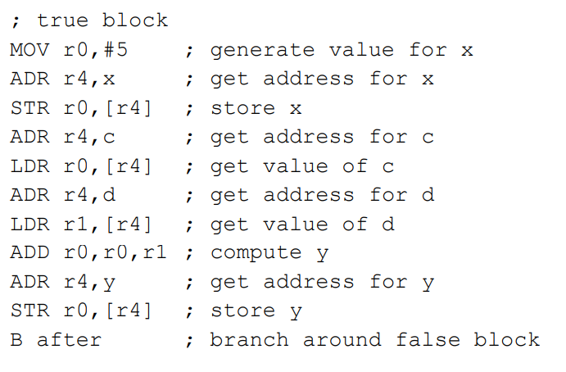

Slide 22
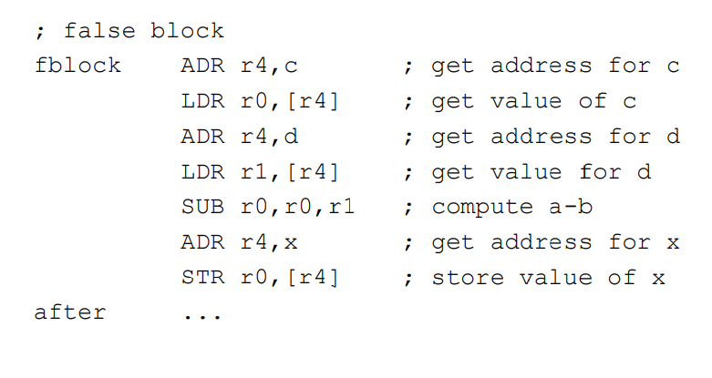

Slide 23
Try these all with ARM.
1. Write a program to find greatest of three numbers.
2. Write a program to SWAP two values without using the third variable.
3. Write a simple code to find out if a number is prime or not.
4. Write a program to SWAP upper and lower nibbles of a number.
5. Write a program to disassemble a value. E.g. 54H to 05H and 04H.
6. Write a program to convert ASCII value to BINARY.
7. Write a program to convert HEXADECIMAL to BINARY.
8. Factorial of a given number.
9. Fibonacci series.
10. Prime number or not.
11. Sorting the numbers in a series.
ARM by Shriram

Slide 24
Queries

